Slide 1

Todașcă Daniel

Slide 2
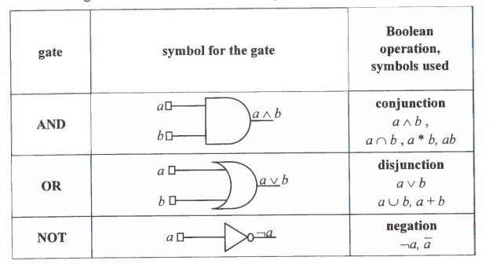
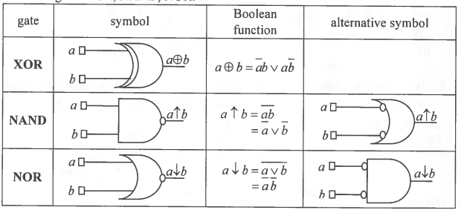
All basic gates and derived gates must be used:

Slide 3
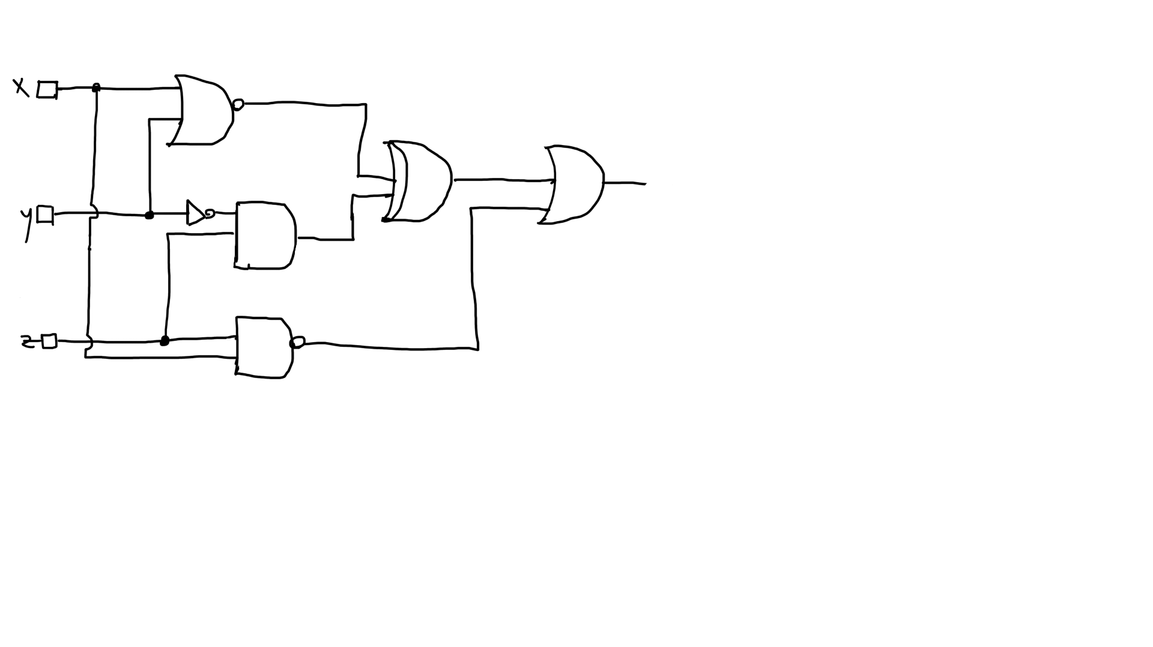

Slide 4


Slide 5


Slide 6


Slide 7


Slide 8
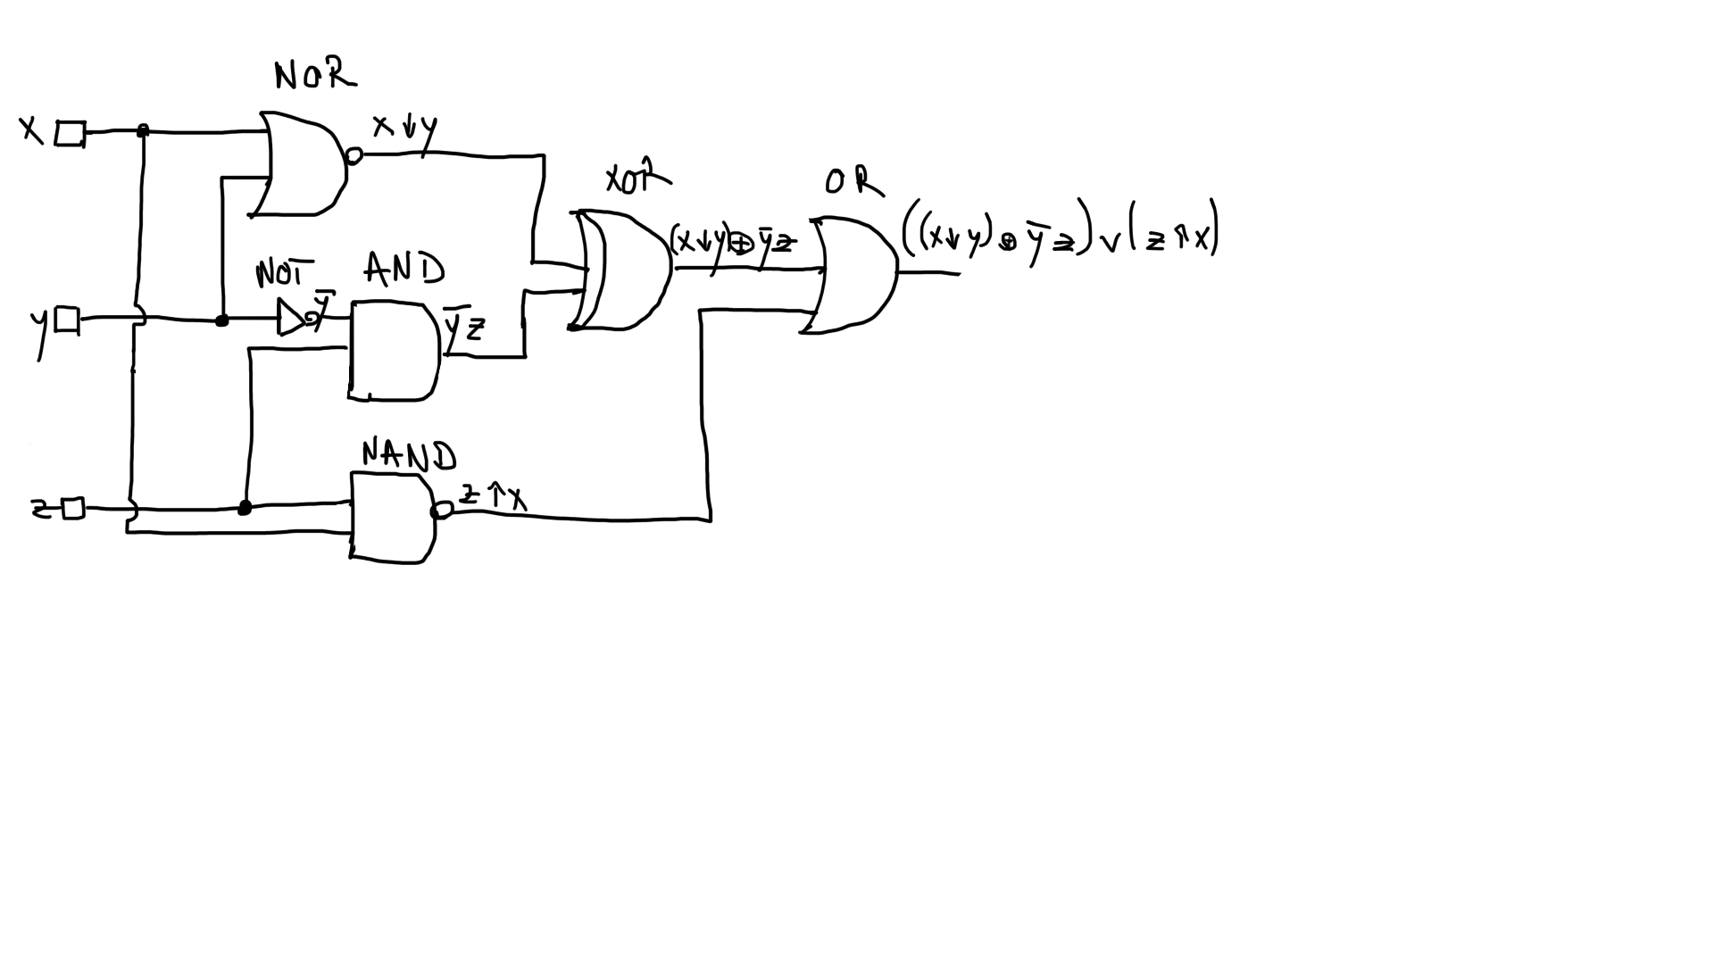
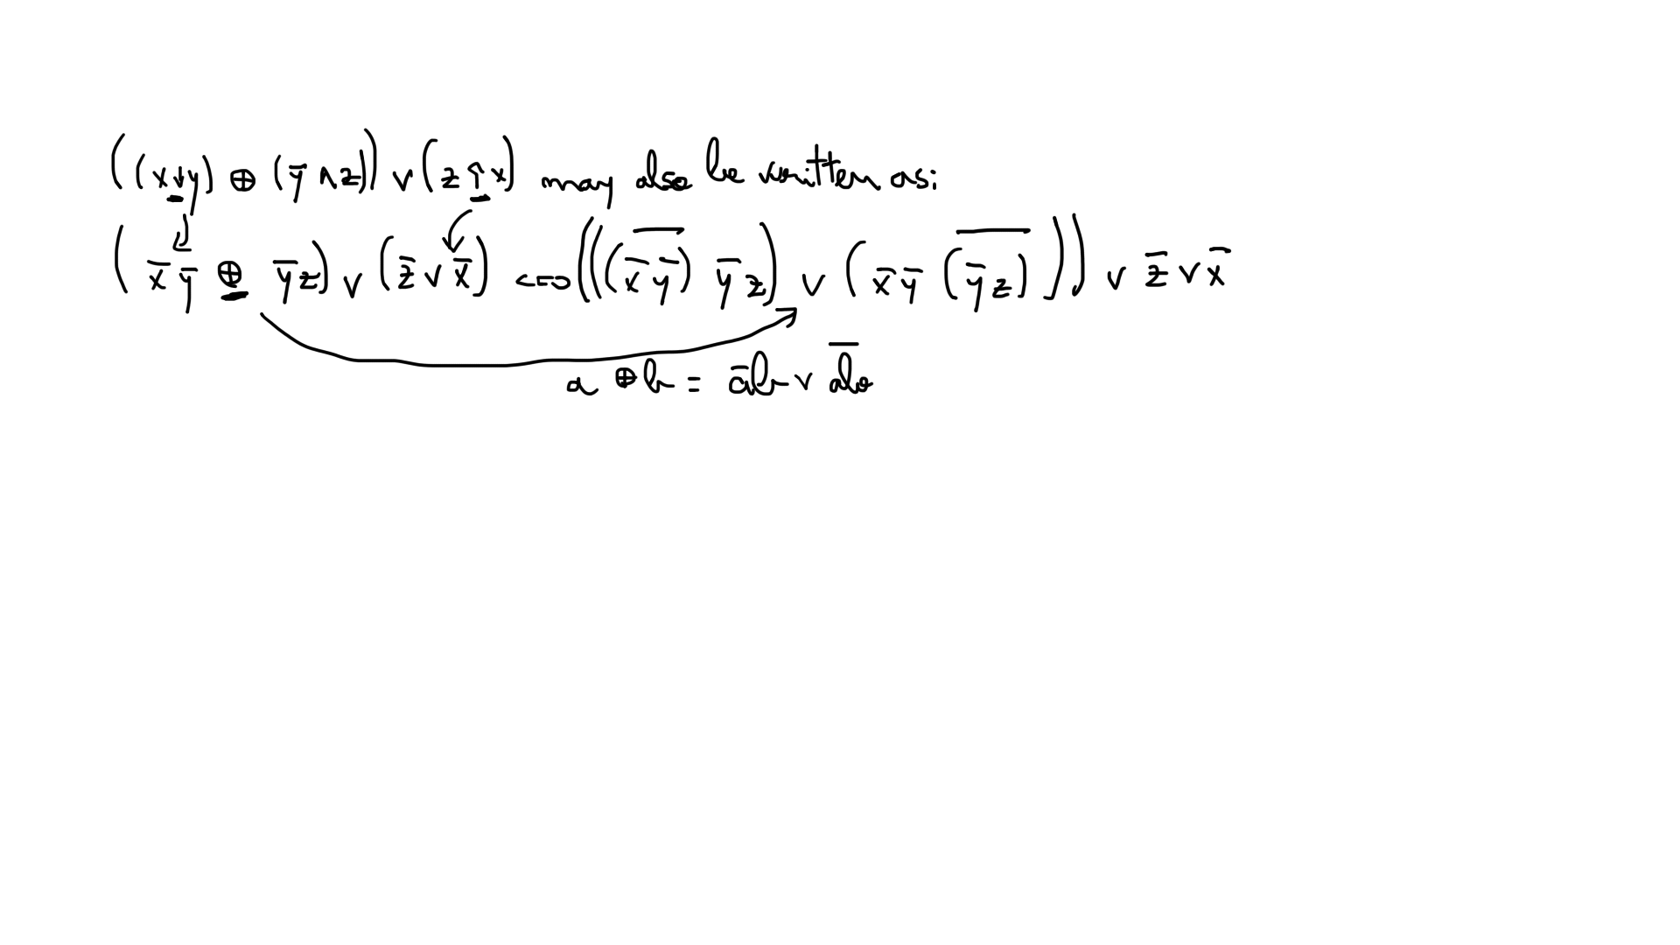

Slide 9
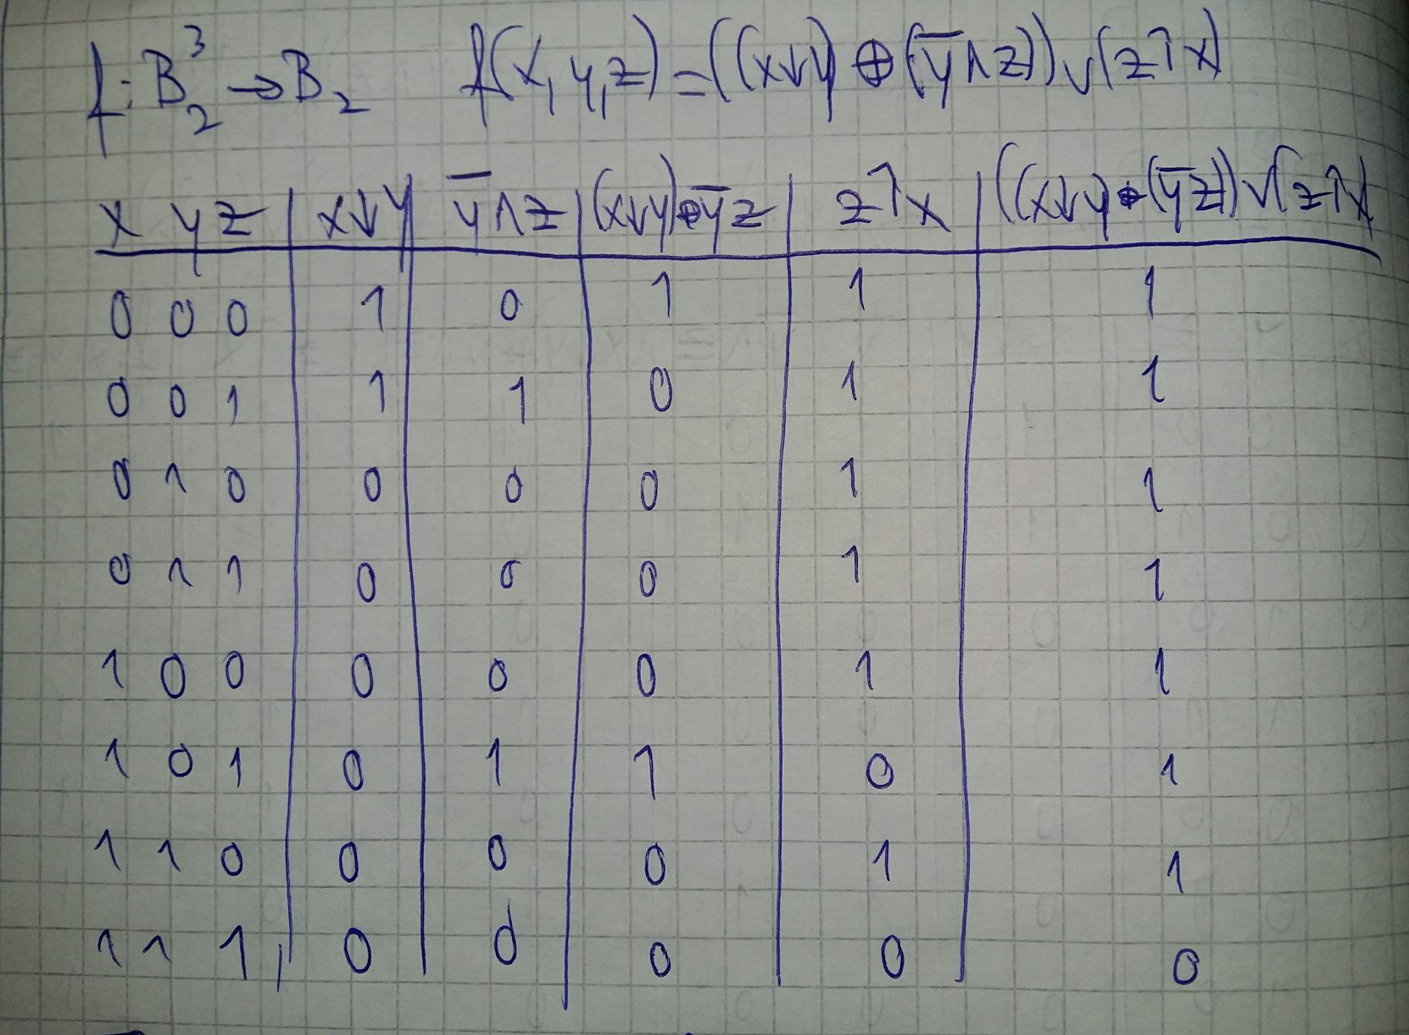
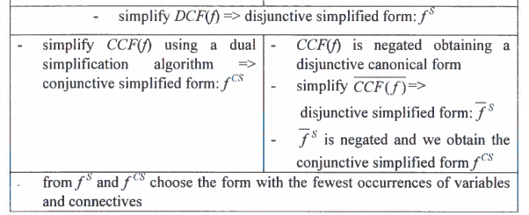
We can simplify the function by using either CCF or DCF.
DCF(f) = m0 ∨ m1 ∨ m2 v m3 ∨ m4 ∨ m5 ∨ m6
CCF(f) = M0
We will first simplify by using CCF.

Slide 10
Veitch diagram - CCF
x
x
CCF(f) = M7
M(f) = C(f) = {M7}, so we are in the first case
f^{CS} = x ∨ y ∨ z
y
 |  | M7
y
z
z
z

Slide 11
Veitch diagram - DCF
Now, we will try to to the same by using the DCF of the boolean function f.
x
x
DCF(f) = m0 ∨ m1 ∨ m2 v m3 ∨ m4 ∨ m5 ∨ m6
y
 | m6 | m2 | m3
m5 | m4 | m0 | m1
y
z
z
z

Slide 12
Veitch diagram - DCF
x
x
 | m6 | m2 | m3
m5 | m4 | m0 | m1
max1 = z
y
y
z
z
z

Slide 13
Veitch diagram - DCF
x
x
 | m6 | m2 | m3
m5 | m4 | m0 | m1
max1 = z
y
max2 = x
y
z
z
z

Slide 14
Veitch diagram - DCF
x
x
 | m6 | m2 | m3
m5 | m4 | m0 | m1
max1 = z
y
max2 = x
y
max3 = y
z
z
z

Slide 15
Veitch diagram - DCF
x
x
y
 | m6 | m2 | m3
m5 | m4 | m0 | m1
M(f) = {max1, max2, max3}
C(f) = {max1, max2, max3}
C(f) = M(f), so we are in the first case:
f(x, y, z) = max1 ∨ max2 ∨ max3
y
f^{DS} = x ∨ y ∨ z
z
z
z

Slide 16
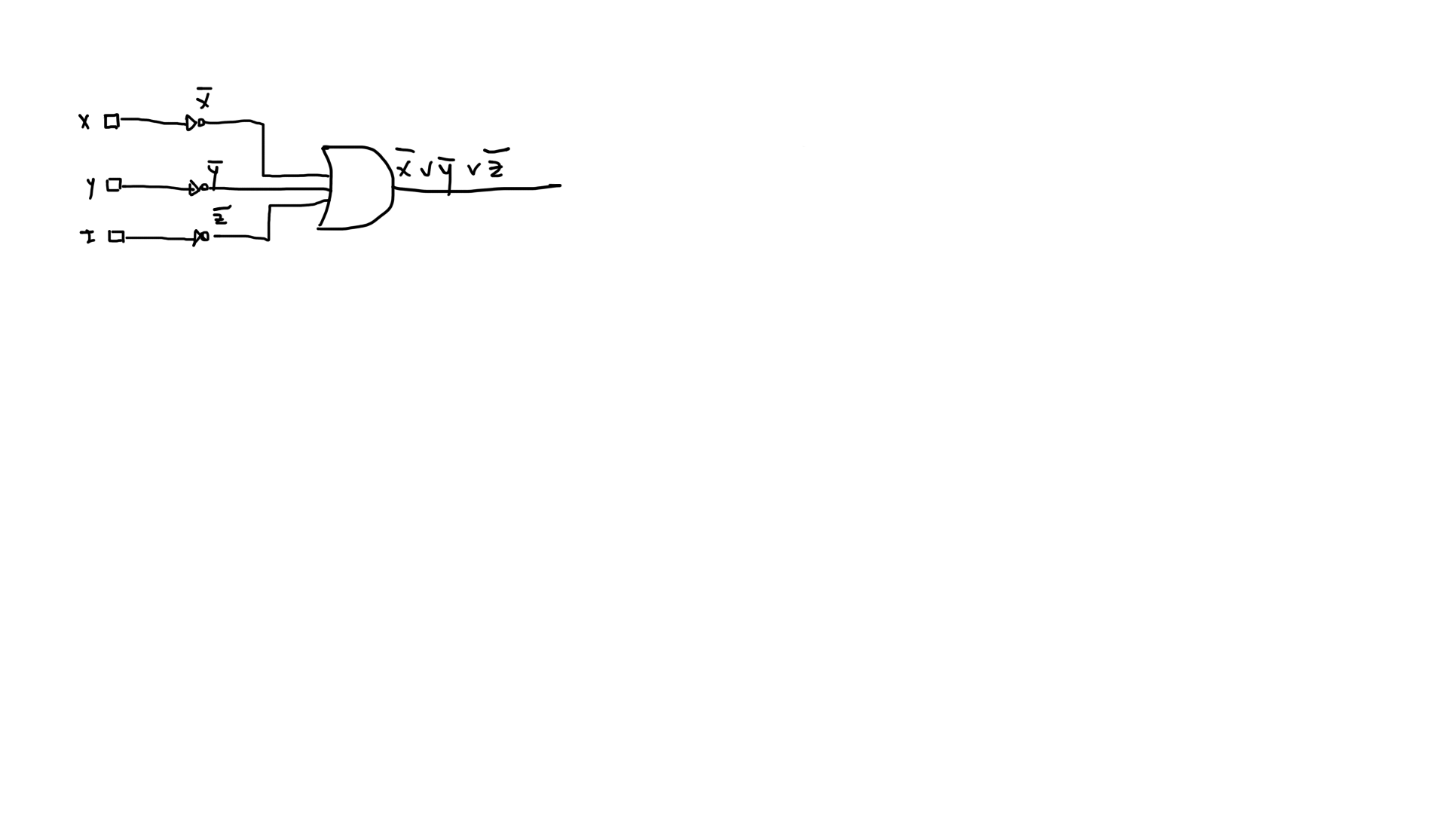
The final version of our logic circuit will contain 3 input wires, 4 logic gates and will look like this:

